Slide 1
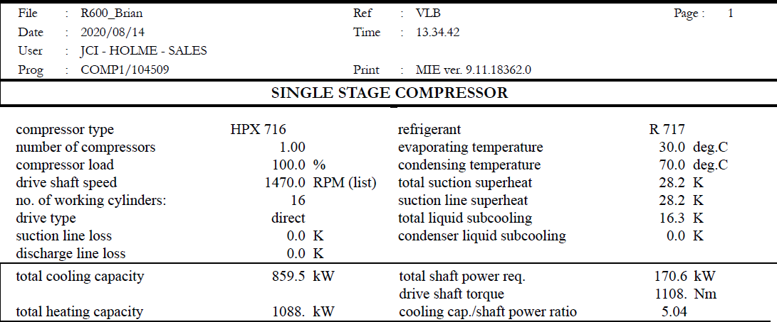
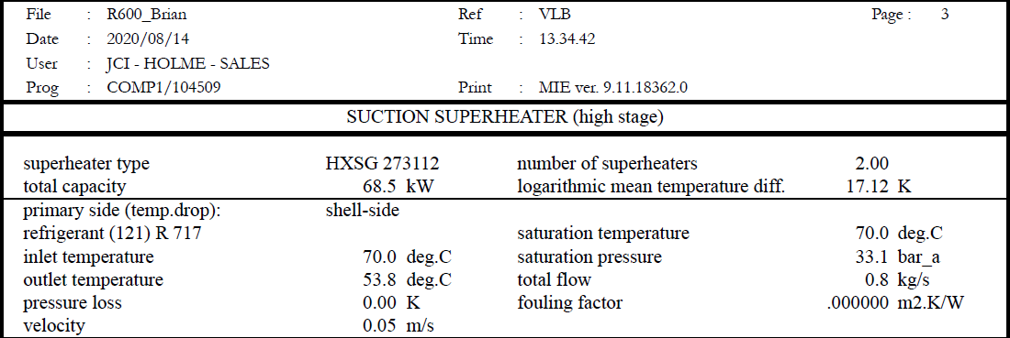
COMP1: Heat balance compressor – suction superheater
27.08.2020
COMP1 issue: is condensing capacity correct?

Slide 2
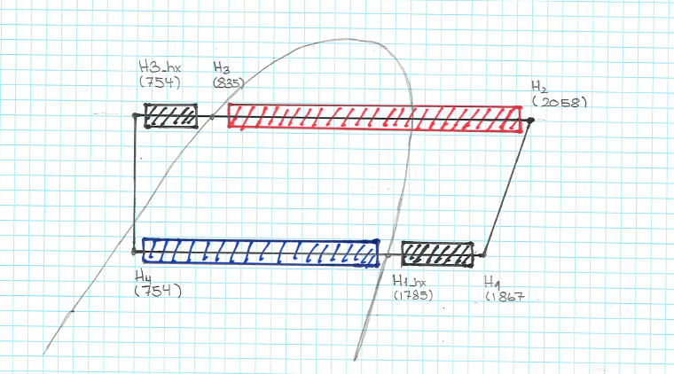
COMP1: Heat balance compressor – suction superheater
27.08.2020

Slide 3
COMP1: Heat balance compressor – suction superheater
27.08.2020
COMP1 (tb0285/06.05.88):
Qe = (H1_hx – H4) x g = 859 kW
W = (H2 – H1) x g = 170 kW
Qc = (H3_hx – H2) x g = 1088 kW - NO
Correct Qc:
Qc = (H3 – H2) x g = 1022 kW

